Slide 1
Online Chatbot based ticketing system
CSE7101- Capstone Project
Review-1
Batch Number: CSE_130
Roll Number | Student Name
20221CSE0359 20221CSE0256 20221CSE0274 | Spandana KG Misba Ain M Priyanka
Under the Supervision of,
Mr.Afroj Alam
Assistant Professor
School of Computer Science and Engineering
Presidency University
Name of the Program: B.Tech CSE
Name of the HoD: Dr. Asif Mohammed
Name of the Program Project Coordinator: Dr. Jayavadivel Ravi
Name of the School Project Coordinators: Dr. Sampath A K , Dr. Geetha A

Slide 2
Problem Statement Number:
Organization: Travel And Tourism
Category (Hardware / Software / Both) : Software
Problem Description:
The implementation of a chatbot for ticket booking in a museum addresses several critical needs, enhancing the overall visitor experience and streamlining museum operations. Here are the key reasons for adopting a chatbot ticket booking system:
1. Improved Customer Service
2. Efficient Handling of High Volumes
3. Cost-Effective Solution
4. Data Collection and Analysis
5. Accessibility
6. Reduced Human Error
7. Multilingual Support
8. Enhanced Marketing and Promotion

Slide 3
Content
Problem Statement
Visitors to popular venues like museums often face significant challenges with manual ticket booking systems.
Inefficiency and Time Consumption: Long queues are common, especially during peak hours and weekends, leading to frustration and a poor visitor experience.
Proneness to Errors: Manual systems are susceptible to errors such as incorrect ticket issuance, double bookings, or lost records, which cause further delays and inconvenience.
Lack of Accessibility: These systems often lack multilingual support and are not easily accessible to users who require instant information or have special queries.
Operational Overhead: Manual ticketing detracts from the overall visitor experience, reduces satisfaction, and can negatively impact the museum's reputation and operational efficiency.

Slide 4
Content (continuation)..
Objectives
The primary objectives of this project are:
To design and develop an intelligent, conversational AI chatbot for booking tickets in a natural, user-friendly manner.
To implement a secure and reliable payment gateway (e.g., Stripe, Razorpay) for seamless online transactions.
To build a multilingual system that can cater to a diverse, international audience.
To create a back-end admin dashboard for staff to monitor bookings, view analytics, and manage event listings.
To enhance the visitor experience by reducing wait times, eliminating booking errors, and providing 24/7 support for inquiries.

Slide 5
Content (continuation)..
Background and Related Work
Traditional Systems: Existing solutions primarily consist of on-site manual ticket counters or basic web-based forms. While functional, these systems are not interactive and contribute to the problems of long queues and high pre-visit friction.
Generic E-commerce Chatbots: Many e-commerce sites use chatbots for customer support. However, they are often generic and not tailored for the specific, event-driven context of ticketing for museums or cultural venues, which involves dates, time slots, and varied ticket types.
Academic Research: Research in Conversational AI, such as work by Cui et al. (2017) on deep learning for chatbot sentence generation, shows the potential for creating highly natural and effective conversational agents. However, there is a gap in applying these advanced agents specifically to the tourism and cultural heritage sector with an integrated analytics component.
Conclusion: This project fills a niche by creating a specialized, multilingual chatbot designed for the unique requirements of museum ticketing, moving beyond simple Q&A to a fully transactional system.

Slide 6
Analysis of Problem Statement
Technology Stack
Frontend (Chat Interface):
Next js: React-based framework for building fast, SEO-friendly web apps.
Tailwind: Utility-first CSS framework for styling.
Backend (Server & Business Logic):
Firebase: Real-time database, authentication, and hosting.
Node.js: JavaScript runtime for building scalable server-side applications.
NLP Service (The Brain)
Google AI: Natural Language Processing for chat understanding and responses.
Deployment:
Google cloud: Cloud hosting, scalability, and infrastructure management.

Slide 7
Analysis of Problem Statement (contd...)
Software Requirements:
Operating System: Windows 11
Development Environment: Visual Studio Code
Runtimes: Node.js
Database: Firebase
API Testing Tool: Postman
Version Control: Git
Hardware Requirements:
Processor: Intel Core i3
RAM: Minimum 8 GB
Storage: Minimum 256 GB of free disk space

Slide 8
Analysis of Problem Statement (contd...)
Manual ticket booking in museums often leads to long queues, errors, and visitor dissatisfaction, especially during peak times. Issues like incorrect tickets, double bookings, and lost records slow down entry and harm the visitor experience.
A multilingual chatbot-based system solves these problems in real time. Visitors can book anytime, anywhere, pay securely, and get instant confirmations—eliminating queues. The chatbot handles thousands of bookings, shares live updates on availability and show timings, and supports multiple languages for global accessibility.
With real-time analytics, museums can track visitor flow, predict peak hours, and plan resources better—leading to faster service, happier visitors, and improved revenue.
Impact: Faster booking • Zero queues • Higher satisfaction • Smarter operations

Slide 9
Innovation or Novel Contributions
Domain-Specific Conversational Intelligence: Unlike generic bots, this system is engineered specifically for the museum/tourism domain. It will be trained to handle context-aware queries about exhibits, artists, and event schedules, providing a highly specialized user experience.
Seamless Integration of Multilingual Support: The chatbot architecture is designed from the ground up to support multiple languages within the same conversational flow, making it accessible to international tourists and non-native speakers.
Actionable Analytics for Operations: The project includes an admin dashboard that presents booking data and visitor traffic patterns. This provides the museum with actionable insights to optimize staffing, manage crowd flow, and make data-driven decisions, directly contributing to SDG 12 (Responsible Production).

Slide 10
Github Link
https://github.com/Span-09/Capstone_Project_CSE_130.git

Slide 11
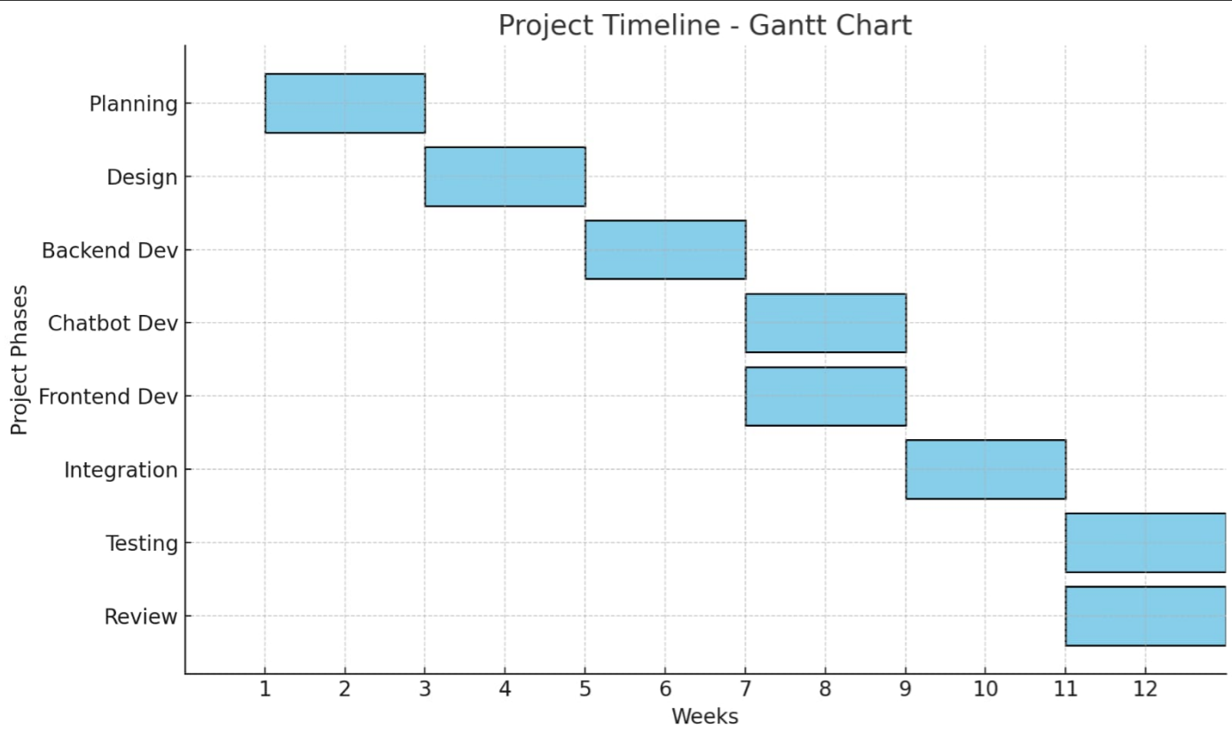
Timeline of the Project (Gantt Chart)

Slide 12
References (IEEE Paper format)
Online Chatbot Based Ticketing System Reference Links:
  [1].https://www.researchgate.net/publication/392265831_Online_Chatbot_Based_Ticketing_System
  [2].JETIR2505189.pdf https://share.google/k7NzmJGyM0GfcRfJA

Slide 13


